Slide 1

CAPITAL DISTRICT INFILL
More homeowners.
Stronger blocks.
Ideas for Albany from a native with years of local real-estate experience.
Garry Holmes | October 2026
Concept illustration - not a built or approved project
Notes:
Generated concept, not an actual Albany property or approved Third Avenue plan. Owner review only.

Slide 2
Three questions to start with.
Resident ownership. Neighborhood care. Potential City and school tax-base benefits.
Where could these ideas help?
Which current housing or neighborhood efforts could these ideas complement? Learn from residents and existing work.
Which land-access idea deserves a closer look?
Compare lot sales, qualified bids and a proposed land-purchase drawing. What is limiting supply or participation today?
Who else should help examine the ideas?
Who else should review this? Seek residents, builders, lenders, appraisers, insurers and educators. Reply: infill@simionmgmt.com.
Ideas for discussion / October 18, 2026
02
Notes:
Resident homeownership, neighborhood care and potential City and school tax-base benefits remain the aims. I am sharing an Albany resident's ideas and inviting constructive feedback. This packet requests no land allocation or contract. Any later business proposal would state my role and interests separately.
Where could these ideas help?: Which existing rehabilitation, homeownership or infill efforts could these suggestions complement? I want to learn from current work and from residents, rather than propose a parallel system.
Which land-access idea deserves a closer look?: Compare published vacant-lot sales, qualified bids and a proposed drawing for the opportunity to buy a lot. What is limiting available properties or buyer participation today? A drawing may be useful where qualified demand exceeds supply.
Who else should help examine the ideas?: Invite residents and renters, city staff, land banks, builders, educators, lenders, appraisers and insurers. Please identify the strongest idea, a practical objection and the next useful question. Reply to infill@simionmgmt.com.
Ideas for discussion. No program, contract, funding or development approval is offered.

Slide 3
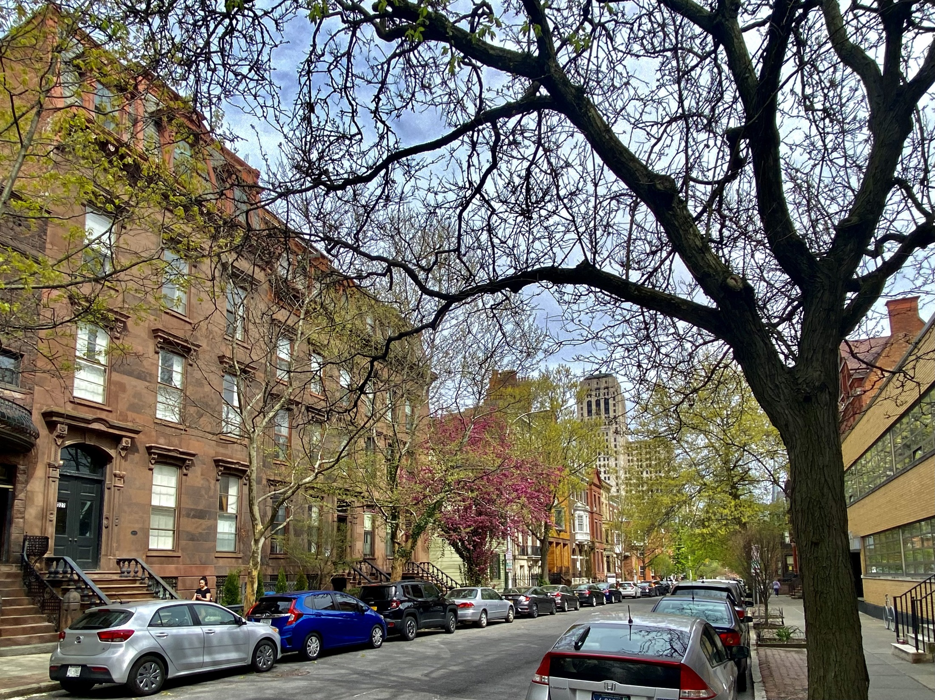
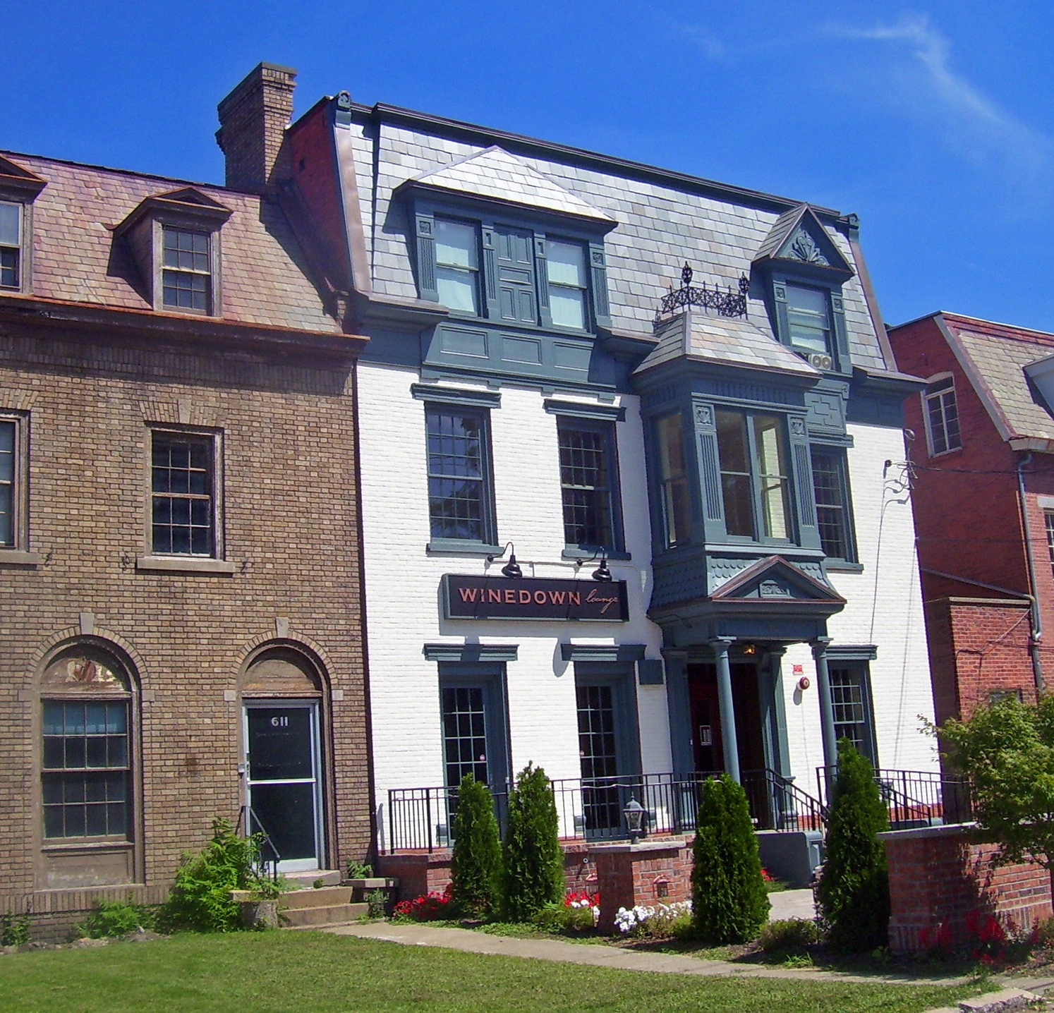
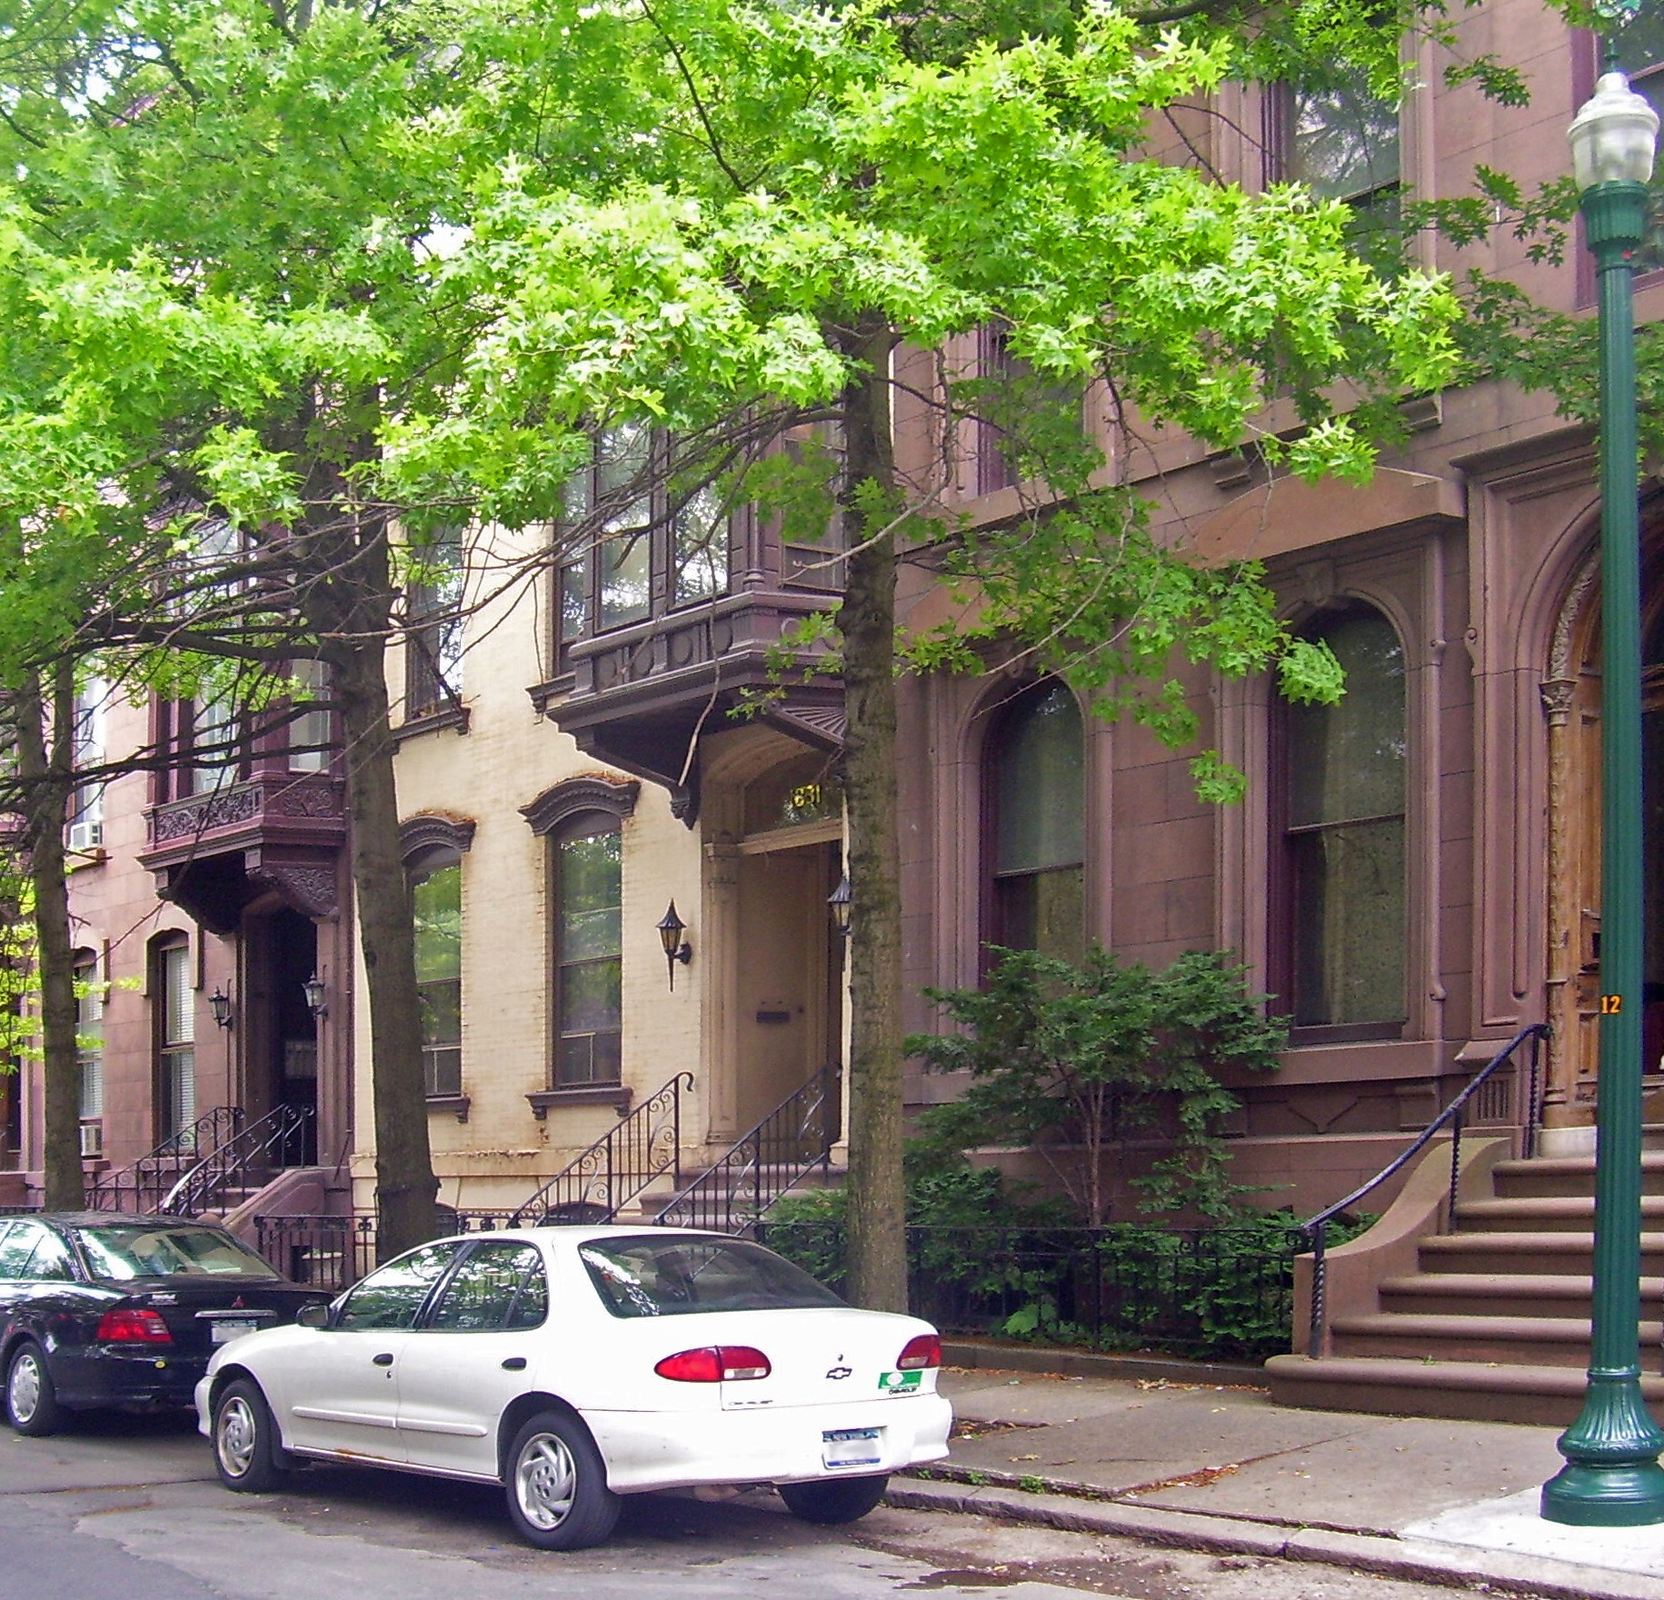
Start with the place. Keep its character.
ALBANY / State Street
SCHENECTADY / Union Street
TROY / Fifth Avenue
Use rehabilitation and compatible infill to strengthen existing neighborhoods.
Actual historical photographs. Regional context; Albany is the initial focus. See photo credits.
03
Notes:
Historical streetscape context, not project inventory, blighted properties, or Garry's completed work. Albany 2022 Andre Carrotflower CC BY-SA4.0; Schenectady 2008 Daniel Case CC BY-SA3.0; Troy 2008 Daniel Case, correction MattWade CC BY-SA3.0. Full asset-page links on credits slide.

Slide 4
Homeownership is the central idea.
5-7
Owner occupancy.
Several ownership paths.
Encourage lasting owner occupancy
Support property upkeep
AHP: 10-year retention / affordable rents;
not 10-year owner residence
YEARS: A SUGGESTED COMMITMENT
Residence, ownership retention, affordable rents and resale protections are separate. Suggested residence terms must not shorten longer protections.
Suggestions for discussion - no rules or commitments are being imposed.
04
Notes:
Proposed minimum occupancy period remains 5-7 years; choose exact term before sale. Counsel/program/lender review required. EOP supports owner-occupied two-family precedent but has no participating properties listed as checked October17. https://www.albanycountylandbank.org/eopp
AHP Vacant Rental Program: ten-year ownership retention and affordable-rental obligations are not a ten-year owner-residence requirement. https://www.ahphome.org/albanyvacantrentalprogram

Slide 5
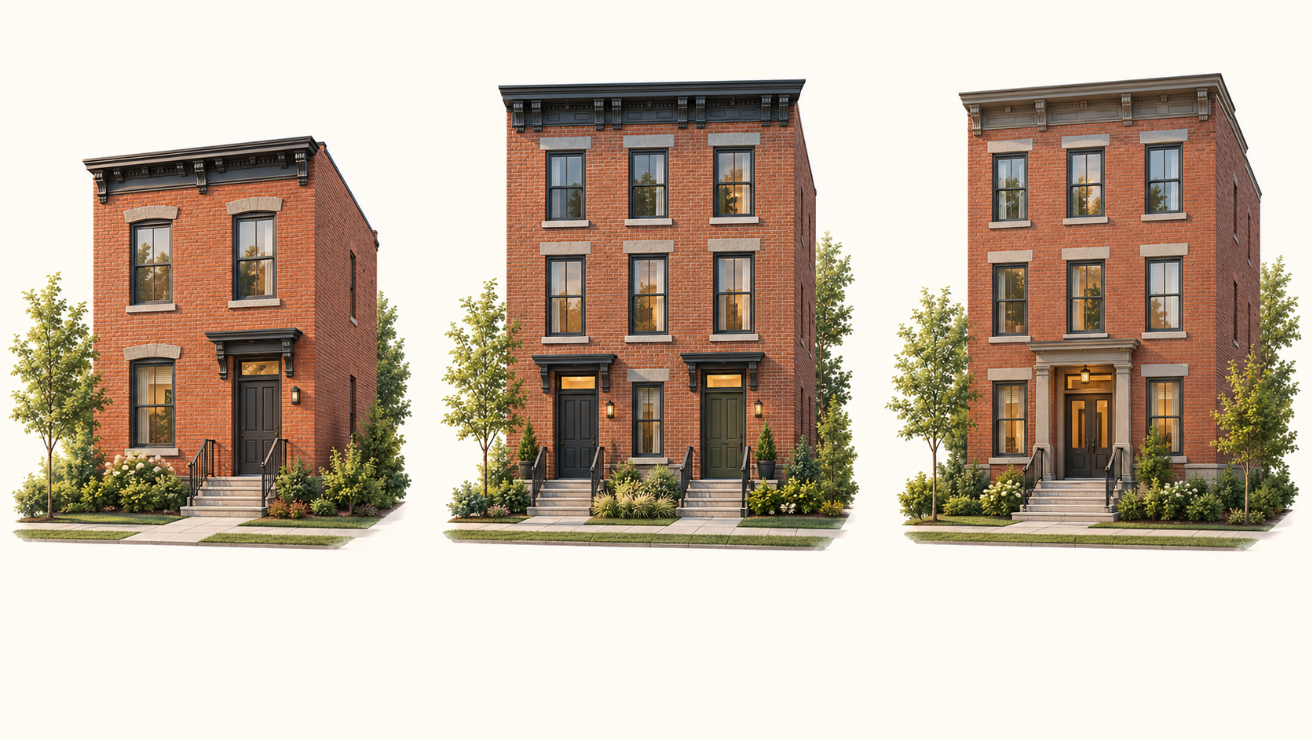
Different homes. One ownership principle.
SINGLE-FAMILY
TWO-FAMILY
THREE-FAMILY
A home for its resident owner
Owner home + rental apartment
Owner home + two rental dwellings
Illustrative possibilities. The building form can respond to the property and neighborhood.
05
Notes:
Generated exterior concepts. Labels suggest possible dwelling types; no interior plan, unit count approval or site fit established.

Slide 6

One possible two-family arrangement.
UPPER HOME
3 bedrooms
2.5 baths
Across two floors
LOWER APARTMENT
2 bedrooms
1 bath
Separate entrance
Spatial illustration only. The rooms shown are not a verified floor plan or bedroom layout.
06
Notes:
AI-generated spatial concept: not a complete floor plan, room count validation or code-compliant design. Intended lower2bed1bath; upper3bed2.5bath over2floors, desired roofaccess.

Slide 7
Four listed lots. An idea to explore.
137-143 THIRD AVENUE, ALBANY
137
139
141
143
25 ft x 100 ft
Nominal lot
25 ft x 100 ft
Nominal lot
25 ft x 100 ft
Nominal lot
25 ft x 100 ft
Nominal lot
Proposed duplex
Owner + rental
Proposed duplex
Owner + rental
Proposed duplex
Owner + rental
Proposed duplex
Owner + rental
Duplexes shown as one option. Singles or triplexes could also be explored.
Parcel rows: 143 / 76.56-4-55; 141 / 76.56-4-56; 139 / 76.56-4-57; 137 / 76.56-4-58.
Saved Land Bank October 2026 sales list, page 2 of 2: $60,000 package asking price, not a project budget. Availability and site fit unconfirmed.
07
Notes:
Source: saved AlbanyLandBankOctober2026ForSaleList.pdf; nominal137/139/141/143ThirdAve25x100each mandatorypackage60000. Current availability/title/survey/zoningunconfirmed. Original owner preference fourduplexes/eightunits. Diagram is native editable planning diagram, not decorative building drawing.

Slide 8
Vacant lots. Three routes to discuss.
A visible pathway from suitable land to lasting resident ownership.
01
02
03
Published lot sales
Competitive bids or auctions
Vacant-lot lottery
Publish sale availability, prices or offer instructions, deadlines and selection criteria. A holdings map does not establish which parcels are for sale.
Consider bids or auctions where the seller has authority. Could selection assess completion capability, resident ownership and price together? A high bid alone does not prove a good neighborhood outcome.
A proposed drawing for the opportunity to BUY a vacant lot at a published price. Land only, not a house. Construction and financing would be separate later steps. No drawing is open.
Ideas for discussion / October 18, 2026
08
Notes:
Albany County Land Bank for-sale list, reviewed October 18, 2026: https://www.albanycountylandbank.org/for-sale-list . Auctions and lottery are proposed options subject to seller authority and applicable requirements.
Ideas for discussion. Ideas only. No lottery, auction or application opened.
Published lot sales: Build on city and land-bank sale processes. Publish which parcels are actually for sale, the price or offer process, deadlines and selection conditions. A holdings map does not establish availability.
Competitive bids or auctions: Discuss bids or auctions where the seller has authority to use them. Could published conditions consider a credible completion plan and resident ownership alongside price? The highest offer alone does not establish a good neighborhood outcome.
A proposed vacant-lot lottery: Consider a transparent drawing for the opportunity to BUY a selected vacant lot at a published price. The selection concerns land only, not a house. This is a proposed idea, not an existing Albany program or an open drawing.

Slide 9
A vacant-lot lottery to explore.
A proposed drawing for the opportunity to BUY VACANT LAND ONLY. A completed house is not the prize.
Publish the opportunity and test demand
Keep selection fair
Publish vacant lots, prices and proposed criteria. Help residents and renters explore lasting ownership. Compare a drawing when qualified demand exceeds supply.
Discuss consistent screening, one household entry, a transparent drawing and a waitlist. Review applicable requirements.
Establish a supported build path before closing
Protect the purpose through completion
Before a lot purchase, explore a builder or supported construction/finance route. Selection does not award or fund a house.
Discuss recorded occupancy/resale safeguards, checks against nominee evasion, hardship and lender rights. Preserve longer program terms.
Ideas for discussion / October 18, 2026
09
Notes:
A proposed drawing for the opportunity to BUY VACANT LAND ONLY. A completed house is not the prize.
Publish the opportunity and test demand: Publish selected vacant lots, prices and proposed owner-occupant criteria. This discussion is intended to help people seeking stable resident ownership, including renters exploring ownership, while respecting existing neighbors. Compare a drawing when qualified demand exceeds supply.
Keep selection fair: Discuss consistent screening, one entry per household, transparent selection and a waitlist. Review fair-housing, accessibility and funding requirements. No local preference or selection rule is adopted here.
Establish a supported build path before closing: A selected buyer could explore a qualified builder, nonprofit-supported route or another credible construction and financing pathway before committing to the lot. A conditional opportunity could allow due diligence. Selection does not fund a house or approve plans.
Protect the purpose through completion: Discuss recorded occupancy and resale safeguards that carry through transfers, with lawful enforcement, lender rights and fair hardship treatment. Explore checks against nominee buyers used to evade resident ownership. Discuss five to seven years of primary residence without shortening longer program terms.
Vacant-land purchase concept only. Seller authority, eligibility and any sale conditions require separate review; no drawing is open.

Slide 10
More than a list of addresses.
Help residents understand the land before they try to buy it.
Show the lot and its conditions
Suggested information includes the seller, current sale status, dimensions, access, utilities, zoning questions and known constraints. Clearly distinguish a potential building lot from a side-yard or green-space opportunity.
Show alternatives without promising a fit
Use a photograph, parcel relationship diagram and different housing concepts to help people ask better questions. Lot assembly may be worth discussing where an individual parcel is too constrained.
Learn from existing programs
The Albany County Land Bank describes Lots for Less, including selected $100 lots and eligibility conditions. On October 18, 2026, its page stated that no lots were participating. A purchase does not establish permission to build.
Ideas for discussion / October 18, 2026
10
Notes:
https://www.albanycountylandbank.org/for-sale-list ; https://www.albanycountylandbank.org/lotsforless . Current availability and intended-use approval remain separate questions.
Ideas for discussion. Ideas only. No lottery, auction or application opened.
Show the lot and its conditions: Suggested information includes the seller, current sale status, dimensions, access, utilities, zoning questions and known constraints. Clearly distinguish a potential building lot from a side-yard or green-space opportunity.
Show alternatives without promising a fit: Use a photograph, parcel relationship diagram and different housing concepts to help people ask better questions. Lot assembly may be worth discussing where an individual parcel is too constrained.
Learn from existing programs: The Albany County Land Bank describes Lots for Less, including selected $100 lots and eligibility conditions. On October 18, 2026, its page stated that no lots were participating. A purchase does not establish permission to build.

Slide 11
Potential City and school tax-base benefits.
TODAY
PROPOSED FUTURE
Vacant, distressed or underused
Maintained homes.
Resident owners.
Vacant lots and distressed houses
Property with unrealized potential
Some parcels already paying taxes
Productive residential property
A stronger City and school tax base
Lasting investment in the neighborhood
I see the tax base as part of the neighborhood renewal story.
Tax effects depend on assessment, exemptions and levy decisions; no dollar forecast is offered.
11
Notes:
No tax forecast or applicable rate determined. City/school calculations separate; taxablebasegrowth doesnotautomaticallyincrease totallevy. Exemptions/abatements/STAR and publiccostmustbeconsidered. https://www.tax.ny.gov/pit/property/exemption/index.htm

Slide 12
Regional work this idea can build on.
REGIONAL EXAMPLE | WHAT IT SHOWS | IDEAS TO EXPLORE
Albany: Legacy City | Two-family rehab for owner-buyers | Connect rehab with resident ownership
Schenectady: Mont Pleasant | Two rehabs + two new homes announced | Compare rehabilitation and compatible infill
Troy: Lansing Fields | 12 new townhomes: construction announced | Consider additional resident-ownership forms
Potential distinction: compare rehab and infill within one resident-ownership approach.
Announcements establish precedents, not current inventory, completion or partnerships in this proposal.
12
Notes:
Primarysources: https://www.albanycountylandbank.org/360-sheridan-ave
https://www.albanycountylandbank.org/news/2024/7/16/albany-county-land-bank-closes-on-first-legacy-city-project
https://www.ahphome.org/albanyvacantrentalprogram
The existing projects are not Garry's developments. Potential strengths are hypotheses; no cost/delivery superiority demonstrated.
Mont Pleasant, December 16, 2025: https://www.schenectadymetroplex.com/news/capital-region-land-bank-approves-400000-for-mont-pleasant-housing-to-provide-new-homes-for-first-time-home-buyers/
Lansing Fields, construction announced August 12, 2026: https://hcr.ny.gov/news/new-york-state-homes-and-community-renewal-announces-start-construction-Lansing-Fields
Source clarification: Metroplex published the December16,2025 article about LandBank approval. LegacyCity July16,2024 article records financing close and planned rehabilitation, not proof of completion. SouthEnd original article confirmsJune8,2026 notwithstanding URL path.
Source clarification: Metroplex published the December16,2025 article about LandBank approval. LegacyCity July16,2024 article records financing close and planned rehabilitation, not proof of completion. SouthEnd original article confirmsJune8,2026 notwithstanding URL path.

Slide 13
The same building. More ways to own.
ONE OWNER
Own both homes. Live in one; rent the other.
TWO CONDO OWNERS
Separate ownership of each dwelling; shared care of roof, structure and grounds.
Illustrative ownership overlay. Separate titles do not establish zoning, financing or program approval.
13
Notes:
Ownership structures are proposals, not approved legal arrangements. NY AG: https://ag.ny.gov/you-buy-co-op-or-condo

Slide 14
Condo and co-op: two ownership paths.
CONDOMINIUM
COOPERATIVE
Buy a deeded home within a shared property.
Buy shares with the right to occupy a home.
Individual mortgage + common charges. Owners share responsibility for common areas and reserves.
Resident corporation owns the property. Maintenance may include taxes, shared costs and building debt.
Explore small-scale and attainable ownership; do not describe condos as new to Albany.
14
Notes:
Albany already has condominiums: https://capitalizealbany.com/strategies/downtown-residential/17-chapel-st/ . NY AG guidance: https://ag.ny.gov/you-buy-co-op-or-condo

Slide 15
Expand ownership. Keep the public purpose.
Different ownership forms need different financing and resident protections.
Lasting residence and neighborhood care
Discuss five to seven years of residence, longer applicable terms, repair support and fair hardship treatment.
Condominiums and cooperatives
Explore separate resident purchases through workable condo or co-op structures, including shared costs and decisions.
Keep voucher and mortgage rules distinct
Review voucher unit eligibility separately from general mortgage products. A whole duplex and one condo/co-op dwelling are different questions.
Ideas for discussion / October 18, 2026
15
Notes:
Different ownership forms need different financing and resident protections.
Lasting residence and neighborhood care: Discuss five to seven years of primary residence, without shortening longer applicable program terms. Ownership, residence, rental affordability and resale restrictions are different obligations. Repair support and fair hardship treatment belong in the discussion.
Condominiums and cooperatives: Small-scale condo or co-op ownership could allow separate resident purchases where the legal structure, association responsibilities and financing are workable. Albany already has condominium examples; this is an idea for broader neighborhood use.
Keep voucher and mortgage rules distinct: Standard HUD voucher homeownership rules identify a one-unit property or a single condo/co-op dwelling. A purchase of an entire two-family building is a different question. Ask the administering agency and lender about the exact property and program; no HOT-PHA, mortgage or grant approval is claimed.
Sources [10]-[13], pages 26-27. This is an ownership discussion, not financing advice or an eligibility determination.

Slide 16
More voices at the table.
Resident knowledge, qualified local businesses and independent professional feedback belong together.
Residents and renters
Invite renters and residents through neighborhood organizations, meetings and accessible formats as well as email. Explore tenant-to-owner counseling.
Local businesses and skills
Invite qualified regional firms and trades. MWBE and service-disabled veteran directories have specific eligibility rules. No preference is claimed.
Lenders, appraisers and insurers
Ask lenders, appraisers and insurers about appraisal gaps, ownership structures and buyer preparation. Record the feedback.
Ideas for discussion / October 18, 2026
16
Notes:
Resident knowledge, qualified local businesses and independent professional feedback belong together.
Residents and renters: Ask existing residents what the block needs. Explore tenant-to-owner counseling and ways for neighborhood renters to learn about opportunities. Any eligibility or preference would need separate review. Use neighborhood organizations, meetings and accessible formats or languages where useful, alongside email.
Local businesses and skills: Invite qualified regional builders, modular suppliers and trades, including minority- and veteran-owned businesses. Official MWBE and service-disabled veteran directories are specific resources, not proof of this proposal's certification or a procurement preference.
Lenders, appraisers and insurers: Ask about appraisal gaps, small-building ownership structures, insurance and the preparation owner-buyers may need. These are requests for professional feedback, not mortgage applications or financing commitments. Record feedback and explain accepted changes or unresolved concerns.
Business resources: https://mwbe.esd.ny.gov/ ; https://sdves.ogs.ny.gov/ . No affiliation, certification or procurement preference is represented.

Slide 17
The layout reference: Henry.
A Canadian builder reference selected to illustrate the arrangement. It does not establish modular manufacture or New York code compliance.
Lower apartment
Lower suite: 2 bedrooms, 1 bathroom, 727 square feet.
Two-floor home above
Upper home: 3 bedrooms, 2.5 bathrooms over two floors, 1,422 square feet.
What still needs checking
Confirm an independent basement entrance/stair route. Width, depth, setbacks, basement suitability and roof access remain unverified; no 25-by-100-foot lot fit is established.
Open Henry’s actual builder drawing ↗
Ideas for discussion / October 18, 2026
17
Notes:
A Canadian builder reference selected to illustrate the arrangement. It does not establish modular manufacture or New York code compliance.
Lower apartment: Authentic Developments describes a separate 727-square-foot basement suite with two bedrooms and one bathroom. Its published drawing shows the room arrangement and stair relationship.
Two-floor home above: The main and second floors together provide 1,422 square feet, three bedrooms and two-and-a-half bathrooms. This is the arrangement Garry selected as the preferred reference.
What still needs checking: Confirm whether the basement suite has its own exterior entrance and stair access separate from the upper home. Overall width and depth are not stated in the available image. Setbacks, basement suitability and roof access need review. Matching room counts does not establish fit on a 25-by-100-foot lot.
Source [20]. Use the original builder drawing link below. Reproduction and construction rights have not been granted; no drawing is reproduced here.
Original drawing: https://authenticdevelopments.com/wp-content/uploads/2016/06/authentic-developments-plan-henry.png
No reproduction/construction permission is established.

Slide 18

Recognize the work already under way.
Local examples are credited to their actual organizations. They are not our projects.
Albany: South End construction
Albany: Land Bank South End update, June 8, 2026. Original construction photographs at source [6].
Schenectady: Summit Avenue
Schenectady: MLB Summit Avenue project and delivery post, sources [16]-[17].
Troy: Lansing Fields
Troy: HCR and CPC August 12, 2026 announcements, sources [15] and [19]. Current availability is unconfirmed.
Historical Albany streetscape / Andre Carrotflower / CC BY-SA 4.0
Ideas for discussion / October 18, 2026
18
Notes:
Local examples are credited to their actual organizations. They are not our projects.
Albany: South End construction: The Land Bank update is dated June 8, 2026, although its URL contains 5/8. It documents South Pearl Street work. Source [6] links the original construction photographs.
Schenectady: Summit Avenue: MLB documents its Summit Avenue redevelopment work and provides an original modular-delivery post. Sources [16] and [17] link the project and original post.
Troy: Lansing Fields: HCR and CPC both issued August 12, 2026 construction announcements. Source [15] is HCR; source [19] is CPC, whose page includes the groundbreaking photograph. These announcements do not establish current home availability.
Full clickable references follow on pages 26-27. Third-party construction photographs are linked at source; no affiliation or endorsement is implied.

Slide 19
Local experience. An open purpose.
An Albany perspective, with room to learn from the wider Capital District.
Why I am contributing
Born and raised in Albany, with rehabilitation, mortgage and former appraisal-assistant experience. No current professional license is claimed.
What this packet asks for
I seek constructive feedback, not land allocation or a contract. Any later business proposal would state my role and interests separately.
A regional conversation
Albany is the starting focus. Learn from Schenectady, Troy and Rensselaer without assuming identical programs or partnerships.
Ideas for discussion / October 18, 2026
19
Notes:
An Albany perspective, with room to learn from the wider Capital District.
Why I am contributing: I was born and raised in Albany. My background includes residential rehabilitation, mortgage work, a previously held real estate appraisal assistant license, meetings with fire department personnel and scheduling occupancy inspections. I claim no current professional license here.
What this packet asks for: I am sharing an Albany resident's ideas and inviting constructive feedback. This packet requests no land allocation or contract. Any later business proposal would state my role and interests separately. My purpose here is to test the ideas, recognize current work and learn what should change, develop or be dropped.
A regional conversation: Albany is the starting focus. Schenectady, Troy and Rensselaer offer additional conversations and comparisons. Local conditions and program availability differ. The four-lot example illustrates a wider idea; it is not a promise of eight units or the limit of a regional opportunity.
Ideas for discussion. No program, contract, funding or development approval is offered.

Slide 20
An invitation to exchange ideas.
01
Connect
Where do these ideas align with Albany priorities?
02
Compare
What can existing local projects and programs teach us?
03
Illustrate
Explore different housing forms on suitable lots.
04
Improve
Which idea should we explore first, what should change, and who else should we hear from?
Rooftop access and modular construction remain options to test, not guaranteed features or savings.
20
Notes:
Concept discussion and exchange of ideas; no implementation assignment is being proposed. Sources: City2025HousingAudit https://www.albanyny.gov/DocumentCenter/View/13572/2025-Housing-Audit-Report-PDF

Slide 21
Renew homes. Keep choices open.
Rehabilitation and compatible infill should both respond to residents and the place.
Give rehabilitation equal attention
Compare rehab with replacement. Consider lead/asbestos, occupied homes, tenant communication and lawful relocation. Aim for lasting resident ownership.
Offer flexible homes and ownership
Keep singles, duplexes, triplexes, condos, co-ops, accessory apartments and suitable conversions open to site-specific review.
Support the people already on the block
Pair upkeep with possible repair support. Ask about displacement and assessment pressures, and explore tenant-to-owner counseling.
Ideas for discussion / October 18, 2026
21
Notes:
Rehabilitation and compatible infill should both respond to residents and the place.
Give rehabilitation equal attention: Compare repair and rehabilitation with replacement before choosing demolition. Consider building condition and possible lead or asbestos hazards. For occupied homes, ask about tenant communication, lawful relocation where needed and avoiding displacement. Lasting resident ownership, rather than rapid resale, is the intended direction.
Offer flexible homes and ownership: Compare single-family homes, duplexes, triplexes, condominiums and cooperatives. Accessory apartments or suitable conversions could offer another route where local rules and the building allow. Consider accessible or ground-floor living, changing household needs and the costs of shared ownership.
Support the people already on the block: Existing renters and homeowners should help shape the discussion. Pair upkeep expectations with possible repair support, and ask about displacement or assessment pressures on existing residents. Seek tenant-to-owner counseling without promising priority, a grant or an affordable rental outcome.
Ideas for discussion. No program, contract, funding or development approval is offered.

Slide 22
Build skills alongside homes.
Explore youth pathways while welcoming older career changers, returning workers and people rebuilding after incarceration.
Match learning to lawful tasks
Separate classroom, shop, shadowing and employment. Under-18 work must be lawful; supervision alone is insufficient.
Connect local tasks to a wider pipeline
Identify regional foundations, utilities, setting and finishing work alongside factory production. Explore learning across multiple projects.
Work through qualified organizations
Invite educators, employers and Habitat to assess pathways and barriers. No unpaid replacement labor, placements or jobs are promised.
Ideas for discussion / October 18, 2026
22
Notes:
Explore youth pathways while welcoming older career changers, returning workers and people rebuilding after incarceration.
Match learning to lawful tasks: Municipalities, schools and qualified employers could explore carpentry and electrical learning, mentoring and possible paid pathways. Classroom, shop learning, shadowing and employment are different. Under-18 site work must be legally permitted; supervision alone is insufficient.
Connect local tasks to a wider pipeline: Modular production may occur in a factory, while foundations, utilities, setting and finishing need qualified crews. Ask which work could stay in the region and support learning across a pipeline of projects. Do not assume one four-lot example supports a training program or reduces costs.
Work through qualified organizations: Invite Habitat, schools, BOCES, colleges, unions and employers to improve the suggestions. Ask about transport, tools, schedules and applicable licensing, insurance or bonding barriers. Training should build skills without replacing qualified trades or assuming unpaid labor. No partnership, placement or job is offered.
Local modular comparison: https://www.habitatcd.org/news/understanding-modular-construction . Training pathways are suggestions for qualified partners to examine.

Slide 23
Prepare the lot. Connect the city.
A parcel-readiness sheet could make land and infrastructure questions easier to discuss.
Record what is known about the property
Combine seller/status, title, dimensions, use and known conditions. Compare rehab with demolition; consider lead/asbestos and other environmental concerns.
Coordinate services and responsibilities
Coordinate utilities, responsibilities and adjacent sites where useful. No municipal funding, cost saving or new job is promised.
Check delivery before choosing a system
Check truck routes, staging, wires, cranes and ground support before choosing modular. A readiness sheet informs review; it grants no approval.
Ideas for discussion / October 18, 2026
23
Notes:
A parcel-readiness sheet could make land and infrastructure questions easier to discuss.
Record what is known about the property: Bring together seller and sale status, title questions, dimensions, intended use, access and known constraints. Compare rehabilitation with demolition. Consider debris, soil, possible lead/asbestos, tree assessment and remediation where justified. A listed parcel is not automatically a buildable lot.
Coordinate services and responsibilities: Municipalities, utility providers and qualified contractors could examine water, sewer, electricity and any lawful fuel-service needs, including relocation where required. Ask whether adjacent sites could be coordinated. Identify responsibilities, timing and resources without promising municipal funding, savings or new jobs.
Check delivery before choosing a system: For modular options, assess truck routes, turning space, staging, overhead wires, crane setup and ground support, street access and neighboring-property protection. Compare these constraints with other construction methods. The readiness sheet would inform feedback, not replace engineering or permits.
Ideas for discussion. No program, contract, funding or development approval is offered.

Slide 24
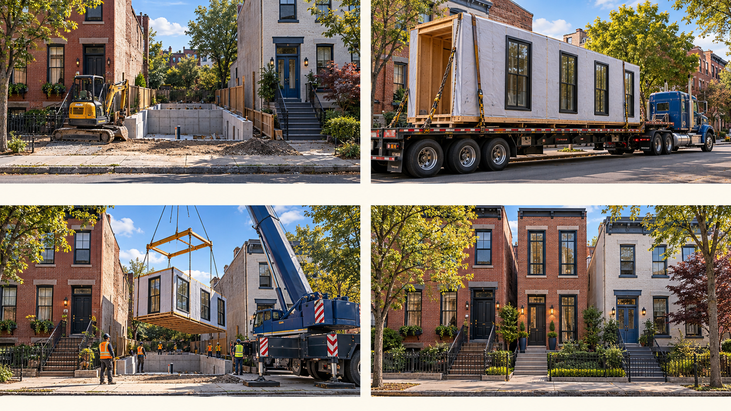
See how modular homes arrive.
Original AI architectural illustration / not actual project photographs
Original AI architectural illustration / not actual project photographs
01 PREPARE
02 TRANSPORT
03 LIFT
04 COMPLETE
Expanded ideas for owner review / October 18, 2026
24
Notes:
Original OpenAI-generated conceptual illustration, not actual photographs or an engineered lift plan. Sequence:prepare foundation/services;planned modular truck delivery;crane placement;connections/finishing/inspection. Actual Habitat Troy,MLB Schenectady and RES4 Bronx source references retained in proposal/source register and private photo gallery. Third-party photo reuse permission remains unresolved.
Real source photographs complement the conceptual construction sequence.
Prepare and plan delivery: Confirm foundations, services, truck route, turning and staging space, crane setup, overhead clearance and neighboring-property protection before selecting a modular system. No site or lift plan is approved here.
Deliver, set and finish: Habitat documents flatbed delivery and crane setting at Park Avenue in Troy, followed by connections, finishing and inspections. Source [18] contains the original photographs. Those photographs are not our work.
Compare more than one example: MLB provides the Summit Avenue project and delivery post [16]-[17]. RES4 documents its historical Bronx Box set [21]. A photograph of a successful set does not establish feasibility on another lot.
Actual source photographs: [16]-[18] and [21]. Reuse permission remains unconfirmed. The separate generated construction image is illustrative, not an engineered lift plan.
Real source photographs complement the conceptual construction sequence.
Prepare and plan delivery: Confirm foundations, services, truck route, turning and staging space, crane setup, overhead clearance and neighboring-property protection before selecting a modular system. No site or lift plan is approved here.
Deliver, set and finish: Habitat documents flatbed delivery and crane setting at Park Avenue in Troy, followed by connections, finishing and inspections. Source [18] contains the original photographs. Those photographs are not our work.
Compare more than one example: MLB provides the Summit Avenue project and delivery post [16]-[17]. RES4 documents its historical Bronx Box set [21]. A photograph of a successful set does not establish feasibility on another lot.
Actual source photographs: [16]-[18] and [21]. Reuse permission remains unconfirmed. The separate generated construction image is illustrative, not an engineered lift plan.

Slide 25
One package. Several owner paths.
Suggestions for land banks, municipalities and willing development or community partners.
Find a lawful route to the land
Bridge the package with outside support
Identify ownership and lawful sale authority. Derelict condition does not make land available.
A willing partner might bridge acquisition/site work. Ask how protections survive transfers and how final pricing is explained.
Offer lots with a credible route forward
Connect energy and household needs
A public seller might offer a vacant-LOT drawing. A nonprofit could instead arrange separate homeowner sales. Any nonprofit drawing needs its own lawful, published process.
Review energy assistance separately for the proposed work. No grant stack, saving or job is guaranteed.
Ideas for discussion / October 18, 2026
25
Notes:
Suggestions for land banks, municipalities and willing development or community partners.
Find a lawful route to the land: Distinguish city-owned land, land-bank holdings, willing private sellers, tax-foreclosed property and unclear ownership. Establish ownership and sale authority. A derelict building needs proper assessment and process; its condition does not make the land available.
Bridge the package with outside support: A willing nonprofit or developer could secure a four-lot package, seek acquisition and site-preparation support, and arrange separate homeowner purchases where feasible. Ask how occupancy and resale protections would carry through every transfer and how final pricing would be explained. Habitat is an example to invite, not a committed partner.
Offer lots with a credible route forward: A municipality or land bank could explore a drawing for eligible vacant lots. A nonprofit could instead acquire a package and arrange separate homeowner sales under applicable requirements. If it chose a drawing for those lots, that would need its own lawful, published process. These are alternative routes, not one required sequence.
Connect energy and household needs: Consider NYSERDA and other suitable energy assistance alongside repair or construction. Check eligibility separately: an existing-home incentive is not automatically new-build funding. Grants, loans, local work and training remain possibilities, not awards or guaranteed savings.
Land-bank process: https://www.albanycountylandbank.org/process-overview ; energy eligibility: https://www.nyserda.ny.gov/All-Programs/EmPower-New-York-Program .

Slide 26
Help ownership last. Hear residents.
Fair expectations, owner preparation and constructive feedback are suggestions to develop together.
Discuss hardship and repair support
Consider hardship, inheritance, divorce and foreclosure-related circumstances. Pair upkeep with possible repair support. Existing rules and lender rights still apply.
Prepare owner-landlords and protect tenants
Explore leases, responsibilities, vacancies and repair mentoring. Include tenants; more homes do not automatically mean affordable rents.
Make the feedback useful and reachable
Seek sourced corrections and ideas through neighborhood groups, meetings, accessible formats and infill@simionmgmt.com. Record responses.
Ideas for discussion / October 18, 2026
26
Notes:
Fair expectations, owner preparation and constructive feedback are suggestions to develop together.
Discuss hardship and repair support: Consider illness, disability, caregiving, bereavement, inheritance, divorce, relocation and foreclosure-related circumstances when discussing temporary absence or early sale. Pair realistic upkeep with possible repair support. Longer program terms and lender rights still apply; no exception or assistance is granted here.
Prepare owner-landlords and protect tenants: Explore mentoring on leases, responsibilities, vacancies and repair planning before buyers rely on rent. Invite tenant-to-owner counseling and protections against displacement. Owner occupancy does not automatically make rents affordable; applicable assistance conditions would govern. No universal rent cap or funded reserve program is adopted.
Make the feedback useful and reachable: Ask for a sourced correction, an existing effort to complement, a resident concern, a site issue and an idea to develop or drop. Invite neighborhood groups, meetings and accessible formats as well as replies to infill@simionmgmt.com. Record feedback and explain changes. No automatic reply or deadline is promised.
Ideas for discussion. No program, contract, funding or development approval is offered.

Slide 27
LET'S EXAMINE THE OPPORTUNITY.
An Albany perspective.
A future worth discussing.
Where could these ideas complement Albany’s housing and neighborhood priorities? Which existing efforts would be most useful to learn from?
Garry Holmes
infill@simionmgmt.com
Garry Holmes | An Albany native sharing ideas for the city’s future.
Notes:
Biography owner-reported. No currentlicense or professionalapprovalauthority claimed. Publicreviewnotfundingapplication.

Slide 28
Ownership, construction and photo sources.
Open the original sources below. The full source register and photo URLs are also printed on proposal pages 26–27.
10 Albany condo precedent
16 MLB: Summit Avenue and videos
11 NY Attorney General: condos/co-ops
17 MLB: original delivery post
12 HUD eligible ownership units
18 Habitat: Troy modular construction
13 NACA HOT-PHA
19 CPC: Lansing Fields
14 Metroplex: Mont Pleasant
20 Authentic Developments: Henry
15 HCR: Lansing Fields
21 RES4: historical Bronx Box set
Albany, State Street - Andre Carrotflower, May 2022; CC BY-SA 4.0
https://commons.wikimedia.org/wiki/File:20220507_-_31_-_Albany,_New_York_-_Row_houses_on_State_Street.jpg
Schenectady, Union Street - Daniel Case, August 2008; CC BY-SA 3.0
https://commons.wikimedia.org/wiki/File:Houses_on_Union_Street,_Schenectady,_NY.jpg
Troy, Fifth Avenue - Daniel Case, June 2008; correction MattWade; CC BY-SA 3.0
https://commons.wikimedia.org/wiki/File:Fifth_Avenue_residences,_Troy,_NY.jpg
Historical context, not our projects. Photo adaptations retain the credited licenses. No endorsement implied.
Ideas for discussion / October 18, 2026
28
Notes:
10 Albany condo precedent
https://capitalizealbany.com/strategies/downtown-residential/17-chapel-st/
11 NY Attorney General: condos/co-ops
https://ag.ny.gov/you-buy-co-op-or-condo
12 HUD eligible ownership units
https://www.law.cornell.edu/cfr/text/24/982.628
13 NACA HOT-PHA
https://www.naca.com/the-naca-hot-pha-program/
14 Metroplex: Mont Pleasant
https://www.schenectadymetroplex.com/news/capital-region-land-bank-approves-400000-for-mont-pleasant-housing-to-provide-new-homes-for-first-time-home-buyers/
15 HCR: Lansing Fields
https://hcr.ny.gov/news/new-york-state-homes-and-community-renewal-announces-start-construction-Lansing-Fields
16 MLB: Summit Avenue and videos
https://www.mlbind.com/summit-avenue-redevelopment/
17 MLB: original delivery post
https://www.linkedin.com/posts/mlb-construction-services-llc_today-is-the-day-our-summit-avenue-redevelopment-activity-7316485057118953472-q0F6
18 Habitat: Troy modular construction
https://www.habitatcd.org/news/understanding-modular-construction
19 CPC: Lansing Fields
https://communityp.com/news-cpc/lansing-fields-begins-construction/
20 Authentic Developments: Henry
https://authenticdevelopments.com/plans/henry/
21 RES4: historical Bronx Box set
https://www.re4a.com/news-archive/2008/2/8/bronx-box-set
PHOTO CREDITS
Albany, State Street - Andre Carrotflower, May 2022; CC BY-SA 4.0
https://commons.wikimedia.org/wiki/File:20220507_-_31_-_Albany,_New_York_-_Row_houses_on_State_Street.jpg
Schenectady, Union Street - Daniel Case, August 2008; CC BY-SA 3.0
https://commons.wikimedia.org/wiki/File:Houses_on_Union_Street,_Schenectady,_NY.jpg
Troy, Fifth Avenue - Daniel Case, June 2008; correction MattWade; CC BY-SA 3.0
https://commons.wikimedia.org/wiki/File:Fifth_Avenue_residences,_Troy,_NY.jpg
CC BY-SA4.0 https://creativecommons.org/licenses/by-sa/4.0/ ; CC BY-SA3.0 https://creativecommons.org/licenses/by-sa/3.0/ . Photos cropped/scaled; adaptations under same license. No endorsement.

